Slide 1







ECO EATS
BENNETT MESS FOOD WASTE MANAGEMENT

Slide 2



TEAM
3
4
1
2
MD SHAHIL
E22CSEU0017
AKSHAT SINGH
E22CSEU0014
HAMDAN KHAN
E22CSEU0018
KUMAR VIPLOVE
E22CSEU0358

Slide 3


ABSTRACT
The goal of our project was to research mess hall food waste at Bennett university and provide recommendations to reduce food waste.
We have implemented a system that tracks food consumption, identifies wastage patterns, and provides recommendations to reduce food wastage.

Slide 4
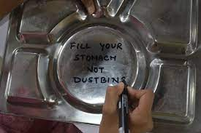
Introduction
The concern of food waste is a global challenge, impacting sustainability and exacerbating issues of hunger. At Bennett university, the mess hall generate substantial food waste. This project aimed to delve into the specific causes of food waste in the mess hall, explore underlying reasons and propose effective measures for waste reduction.

Slide 5

Methodology
Basic Arithemetic operations
Statistics : Mean , Median , Standard deviation
Probability Concepts : Randomization , item-based prob. Of wastage
Data Summation
Threshold calculation
Data Visualization : Scaling axes , bar positioning
.

Slide 6
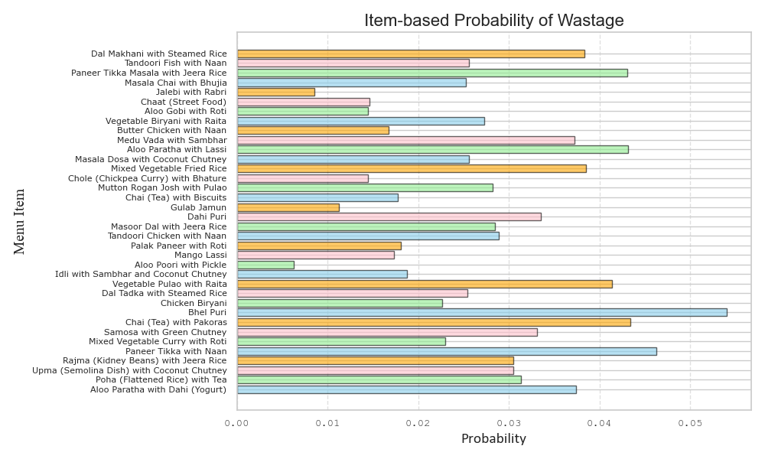
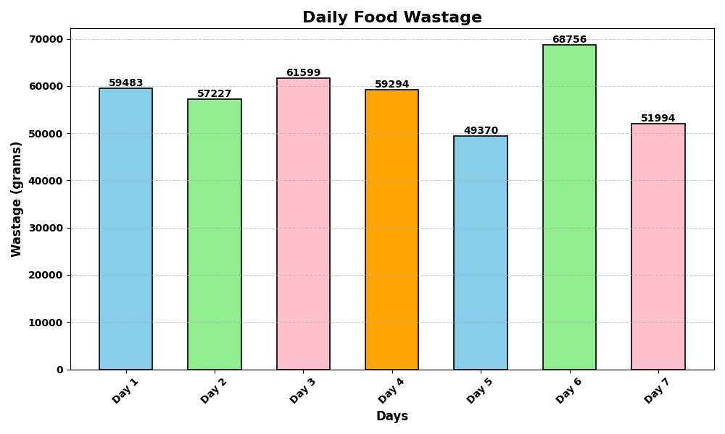
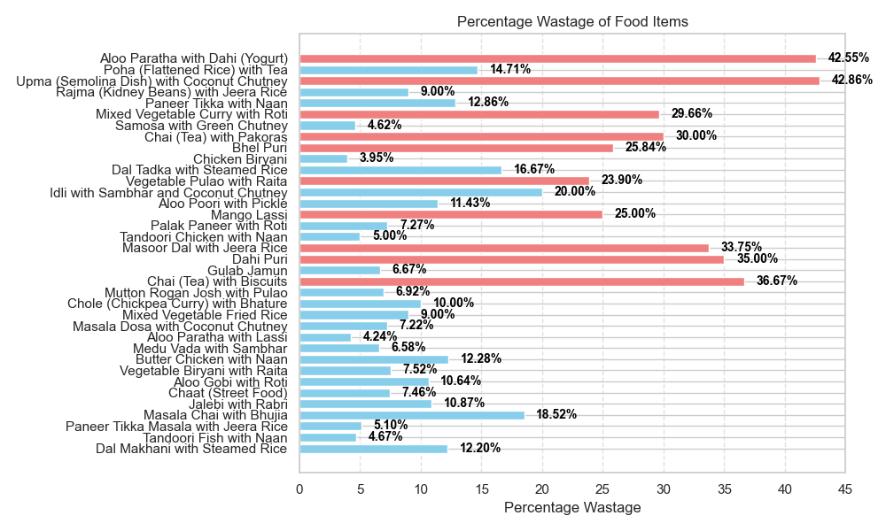
Results

Slide 7
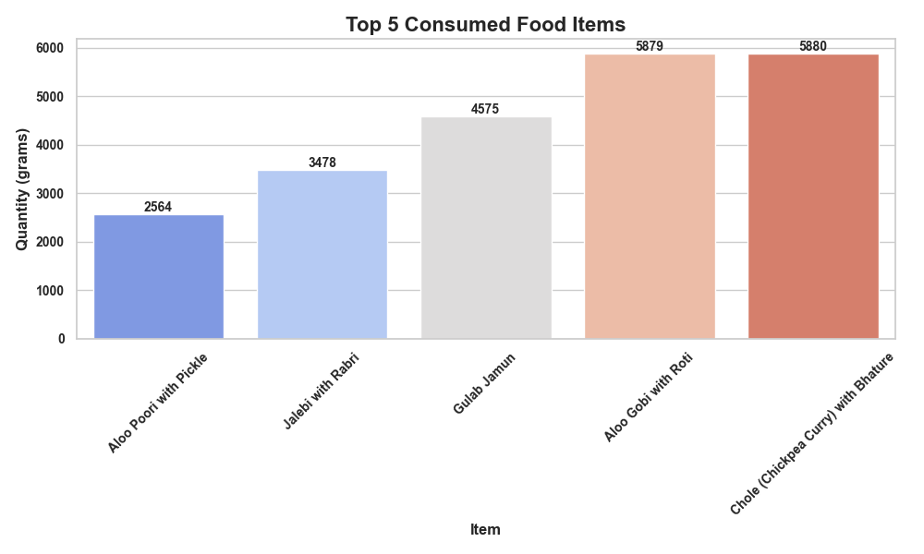
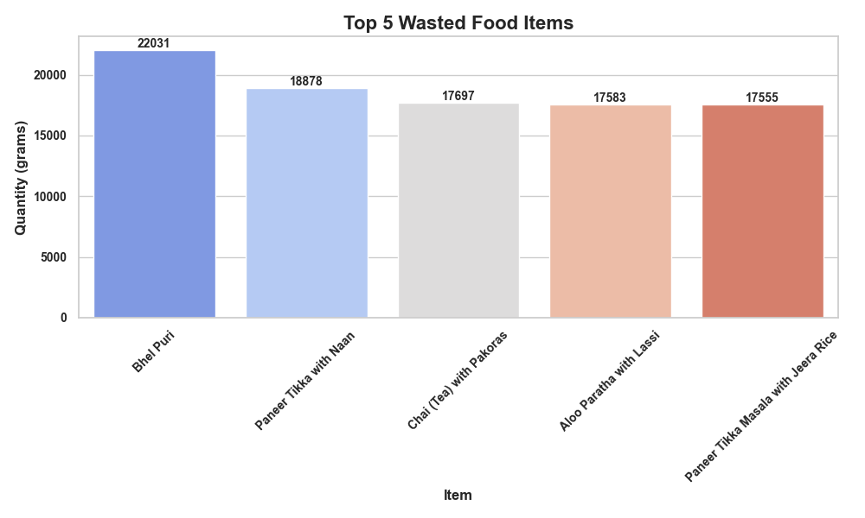
Conclusion
The Mess Food Waste Management System is a promising solution to tackle food wastage in college messes.
By providing data-driven insights, it enables better decision-making and cost savings.
As we move forward, we aim to further refine the system and scale its implementation to other educational institutions.

Slide 8



THANK YOU

